Slide 1


Shri Sai Shikshan Sanstha’s
NAGPUR INSTITUTE OF TECHNOLOGY, NAGPUR
Survey No.13/2, Mahurzari, Near Fetri, Katol Road, Nagpur-441501
Department of Computer Science and Engineering
Project Progress Seminar – 2, on
FARM CONNECT: PATHWAY TO PROGRESS
Presented By
Marshal Alone, Vaishnavi Getme, Mrunali Umak, Sanskruti Patil, Aditya Kawale
https://nit.edu.in/computer-science-engineering/

Slide 2
Shri Sai Shikshan Sanstha’s
NAGPUR INSTITUTE OF TECHNOLOGY, NAGPUR
Survey No.13/2, Mahurzari, Near Fetri, Katol Road, Nagpur-441501
INDEX
●Project Title & Group Details
●Problem Definition, Aim & Objectives
●Recap of Seminar–I Work
●Current Progress since last seminar
●System Design / Implementation screenshots / Developed Modules
●Testing & Results
●Challenges faced and Solutions implemented
●Remaining Work & Timeline
●Budget Utilisation & Resource Requirements
●Conclusion & Future Scope
https://nit.edu.in/computer-science-engineering/

Slide 3
Shri Sai Shikshan Sanstha’s
NAGPUR INSTITUTE OF TECHNOLOGY, NAGPUR
Survey No.13/2, Mahurzari, Near Fetri, Katol Road, Nagpur-441501
Project Title & Group Details
FARM CONNECT: PATHWAY TO PROGRESS
Empowering Indian Farmers Through Innovation
Presented By
Marshal Alone
Vaishnavi Getme
Mrunali Umak
Sanskruti Patil
Aditya Kawale
https://nit.edu.in/computer-science-engineering/

Slide 4
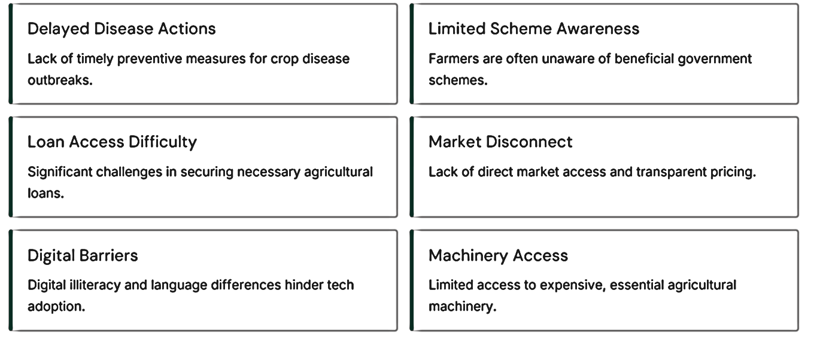
Shri Sai Shikshan Sanstha’s
NAGPUR INSTITUTE OF TECHNOLOGY, NAGPUR
Survey No.13/2, Mahurzari, Near Fetri, Katol Road, Nagpur-441501
Problem Definition
https://nit.edu.in/computer-science-engineering/

Slide 5
Shri Sai Shikshan Sanstha’s
NAGPUR INSTITUTE OF TECHNOLOGY, NAGPUR
Survey No.13/2, Mahurzari, Near Fetri, Katol Road, Nagpur-441501
Aim & Objectives
To develop a comprehensive, multi-functional Agriculture Support System that empowers farmers by providing real-time information, market access, early warnings, and easy access to schemes, loans, and machinery through a user-friendly interface that supports regional languages and voice inputs.
Real-time Information
Providing instant, relevant data to farmers.
Enhanced Market Access
Connecting farmers directly to buyers for fair prices.
Early Warning Systems
Alerting farmers to potential threats like disease outbreaks.
Access to Resources
Facilitating easier access to schemes, loans, and machinery.
https://nit.edu.in/computer-science-engineering/

Slide 6
Shri Sai Shikshan Sanstha’s
NAGPUR INSTITUTE OF TECHNOLOGY, NAGPUR
Survey No.13/2, Mahurzari, Near Fetri, Katol Road, Nagpur-441501
Conducted planning and requirement analysis for the Agriculture Support System project.
Defined project scope, aim, and objectives.
Identified key challenges faced by farmers, buyers, and institutions.
Gathered requirements through surveys, interviews, and literature review.
Finalized the technology stack for app/web development.
Prepared an initial project roadmap and module planning.
Created a basic wireframe and concept design for the system.
Recap of Seminar–I Work
.
https://nit.edu.in/computer-science-engineering/

Slide 7
Shri Sai Shikshan Sanstha’s
NAGPUR INSTITUTE OF TECHNOLOGY, NAGPUR
Survey No.13/2, Mahurzari, Near Fetri, Katol Road, Nagpur-441501
Current Progress since last seminar
Progress – September
Completed UI/UX design and wireframing for the Agriculture Support System.
Conducted user needs analysis for farmers, buyers, and institutions to define core requirements.
Finalized the technology stack for app/web development.
Designed app and web interfaces for each module with a focus on usability.
Prepared user flow diagrams for all system modules to ensure seamless navigation.
Developed voice interface layouts for multiple regional languages (Hindi, Marathi, etc.).
https://nit.edu.in/computer-science-engineering/

Slide 8
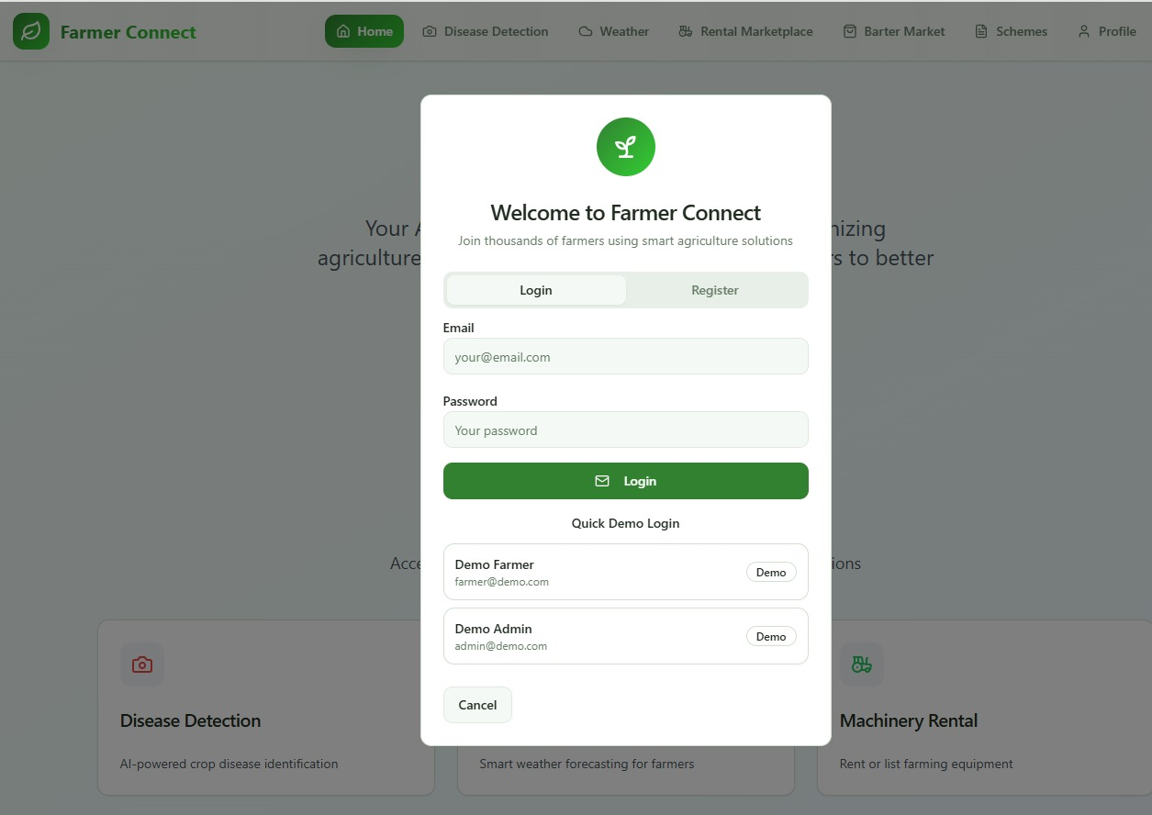
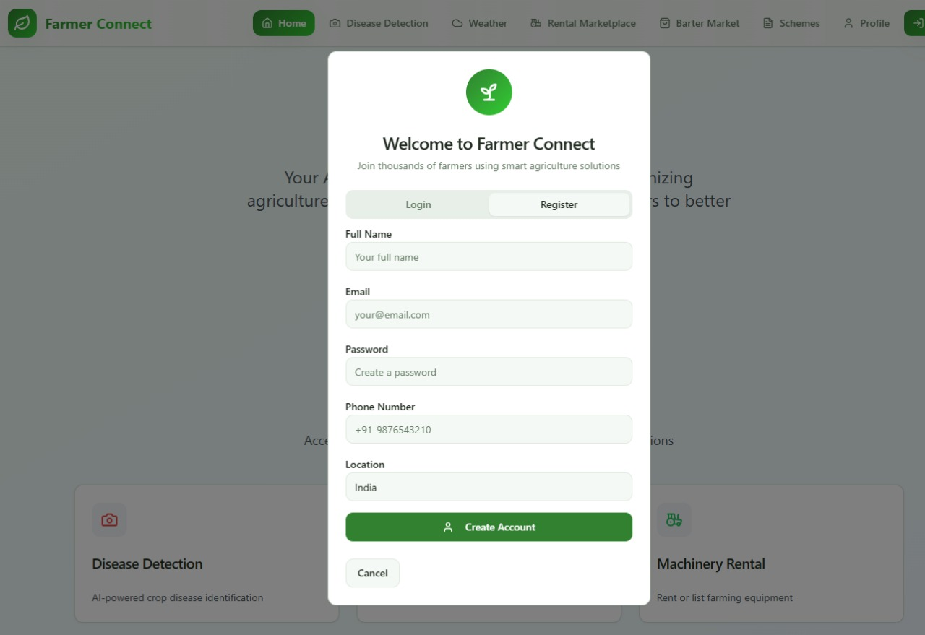
Shri Sai Shikshan Sanstha’s
NAGPUR INSTITUTE OF TECHNOLOGY, NAGPUR
Survey No.13/2, Mahurzari, Near Fetri, Katol Road, Nagpur-441501
System Design / Implementation screenshots / Developed Modules
https://nit.edu.in/computer-science-engineering/

Slide 9
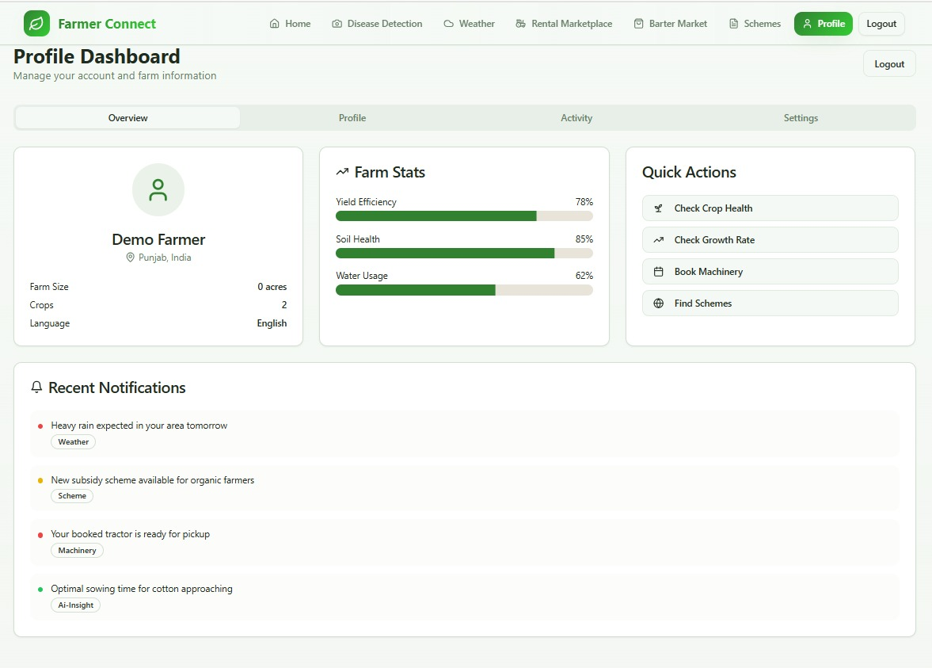
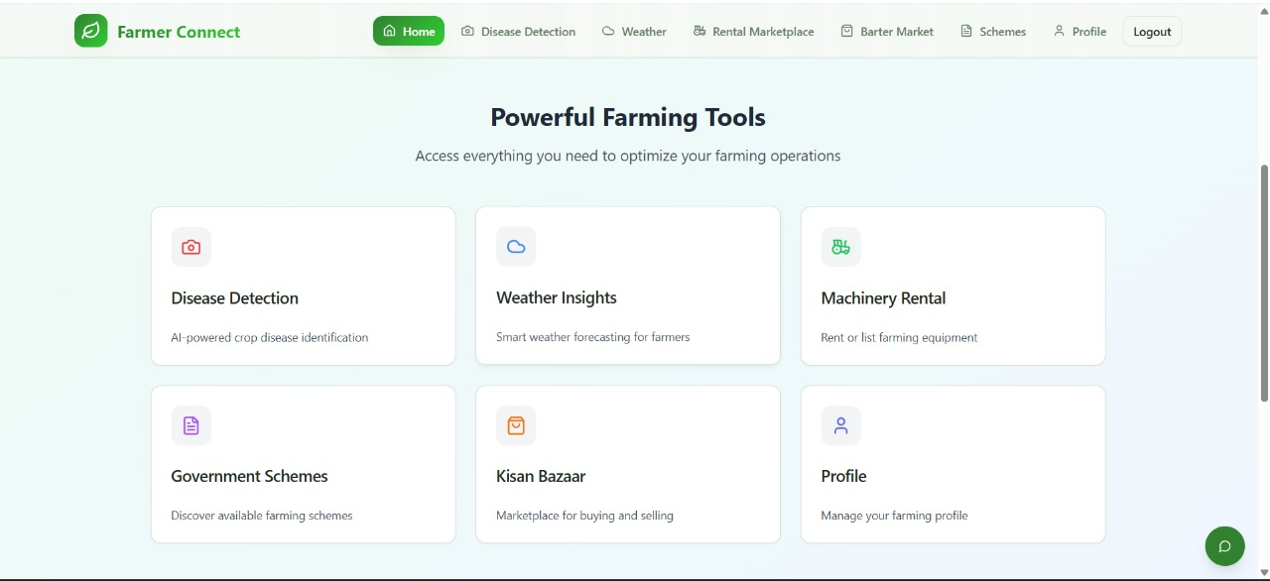
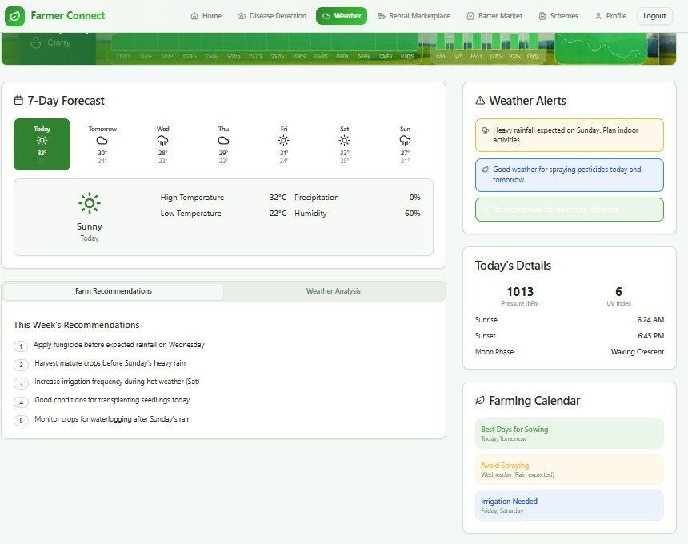

Slide 10
Shri Sai Shikshan Sanstha’s
NAGPUR INSTITUTE OF TECHNOLOGY, NAGPUR
Survey No.13/2, Mahurzari, Near Fetri, Katol Road, Nagpur-441501
Testing & Results
UI/UX Testing: Conducted usability tests with a sample group of users to ensure intuitive design and smooth navigation.
Functionality Testing: Verified working of core interface elements across different devices (mobile, tablet, desktop).
Voice Interface Testing: Tested voice recognition accuracy for Hindi and Marathi inputs; achieved satisfactory recognition rate.
Performance Testing: Assessed app responsiveness and load times for different modules.
Preliminary Results:
Positive user feedback on interface simplicity and accessibility.
Voice input feature functioning with >85% accuracy in tested scenarios.
App interfaces and flows validated for ease of use by target user groups.
https://nit.edu.in/computer-science-engineering/

Slide 11
Shri Sai Shikshan Sanstha’s
NAGPUR INSTITUTE OF TECHNOLOGY, NAGPUR
Survey No.13/2, Mahurzari, Near Fetri, Katol Road, Nagpur-441501
Challenges faced and Solutions implemented
1.Challenge: Designing an intuitive UI for diverse user groups with varying technical skills.
Solution: Created simple, icon-based navigation with minimal text and voice guidance for. ease of use.
2.Challenge: Ensuring accurate voice recognition for multiple regional languages (Hindi, Marathi, etc.).
Solution: Integrated advanced multilingual voice recognition APIs and tested extensively with native speakers.
3.Challenge: Identifying comprehensive user needs across farmers, buyers, and institutions.
Solution: Conducted surveys, interviews, and field visits to gather relevant requirements.
4.Challenge:Balancing feature complexity with performance efficiency.
Solution:Optimized code structure, selected a robust technology stack, and modularized system components.
5.Challenge:Maintaining consistency in design across mobile and web interfaces.
Solution:Developed standardized style guides and reusable UI components for cross-platform uniformity.
https://nit.edu.in/computer-science-engineering/

Slide 12
Shri Sai Shikshan Sanstha’s
NAGPUR INSTITUTE OF TECHNOLOGY, NAGPUR
Survey No.13/2, Mahurzari, Near Fetri, Katol Road, Nagpur-441501
Remaining Work & Timeline
October
Begin core module development for the Agriculture Support System.Develop advanced modules with planned functionality
November
Implement crop disease prediction module (ML or rule-based).Develop government schemes recommender and loan eligibility checker.Create equipment rental system with calendar and location filters.Develop AI chatbot with multilingual and voice support.Begin backend database integration.
December
Complete Integration of all modules.Conduct mid-level testing of integrated components.
January
Perform final testing (UI, functional, usability, and security).Setup deployment environment and combine front-end and back-end modules. Integrate APIs: speech-to-text, weather data, UPI payments.
Deploy system on cloud platform (Firebase/AWS).Prepare for pilot demo with real users
February
Complete documentation and prepare for demo presentation
March
Conduct final presentation and project submission. Finalize user manuals and project report.
Create PPT and video demo. Submit complete project report.
https://nit.edu.in/computer-science-engineering/

Slide 13
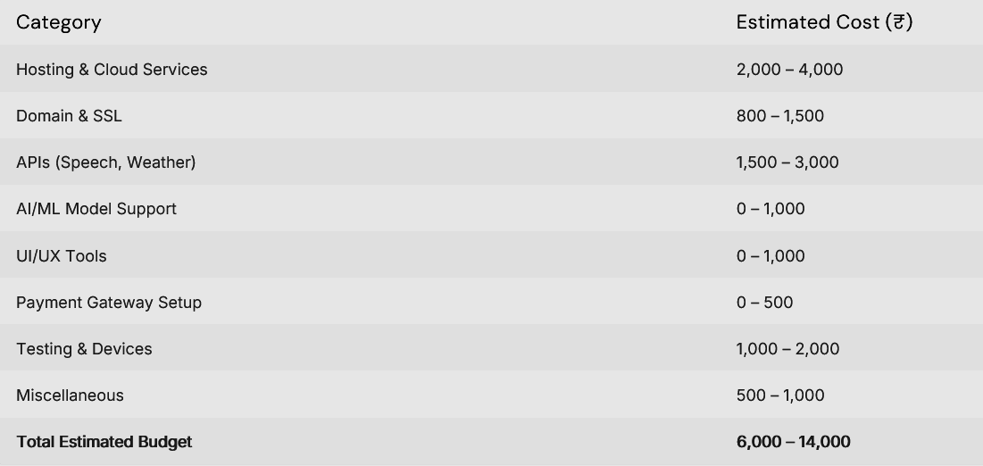
Shri Sai Shikshan Sanstha’s
NAGPUR INSTITUTE OF TECHNOLOGY, NAGPUR
Survey No.13/2, Mahurzari, Near Fetri, Katol Road, Nagpur-441501
Budget Utilisation & Resource Requirements
Resource Requirements
Cloud hosting account (Firebase/AWS).
Voice recognition API subscriptions for multiple languagesTesting devices (smartphones, tablets, computers).
Access to agricultural datasets for ML modules.
Skilled manpower for final testing and deployment.
https://nit.edu.in/computer-science-engineering/

Slide 14
Shri Sai Shikshan Sanstha’s
NAGPUR INSTITUTE OF TECHNOLOGY, NAGPUR
Survey No.13/2, Mahurzari, Near Fetri, Katol Road, Nagpur-441501
Conclusion & Future Scope
Conclusion
The Agriculture Support System is progressing as planned, with UI/UX design, voice interface layouts, and core module planning completed.
Development of advanced modules and backend integration is underway, ensuring the project meets its aim of empowering farmers through a multi-functional, multilingual platform.
Preliminary testing shows positive results, especially in usability and voice input accuracy.
Future Scope
Expand the system to include AI-based predictive analytics for crop yield and weather patterns.
Integrate IoT-based sensors for real-time soil and crop health monitoring.
Enhance chatbot capabilities with deep learning for natural conversation in multiple regional languages.
Scale platform for nationwide adoption with additional support for more languages and localized schemes.
Develop a mobile-first version optimized for rural internet connectivity and low-end devices.
https://nit.edu.in/computer-science-engineering/

Slide 15

THANK YOU

